Slide 1
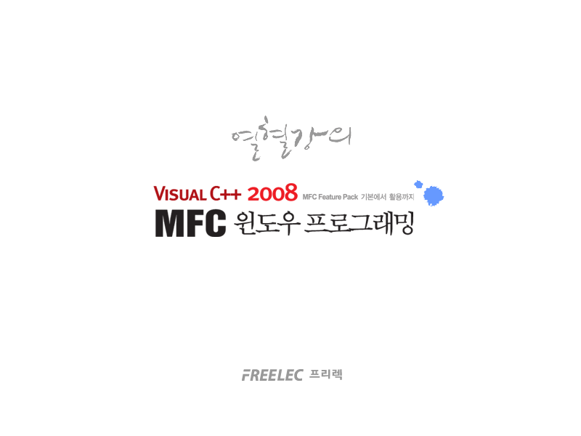

Slide 2
Part 4
  MFC Feature Pack

Slide 3
Chapter 24
  About MFC Feature Pack

Slide 4
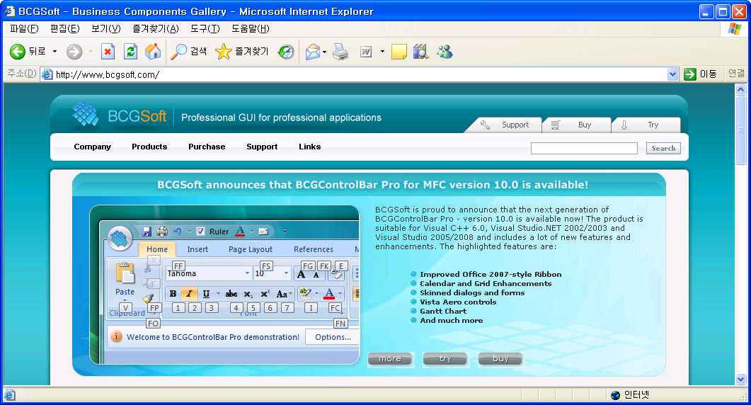
Visual Studio 2008 Service Pack 1
Visual Studio 2008 Service Pack 1 (iso)
http://www.microsoft.com/downloads/details.aspx?displaylang=ko&FamilyID=27673c47-b3b5-4c67-bd99-84e525b5ce61
2008년 4월 : 영문 버전이 정식으로 공개.
2008년 11월 : Visual Studio 2008 Service Pack1에 포함되었음.
BCG soft(http://www.bcgsoft.com) 사에서 제공한 라이브러리.
Office 2007의 리본 메뉴를 구현하는 라이브러리를 포함.
Visual Studio 2005의 스마트(Smart) 도킹(Docking) 창(Pane), 제공.
확장 트루 컬러 도구 모음(Toolbar), 메뉴 표시줄(Menubar) 제공.

Slide 5
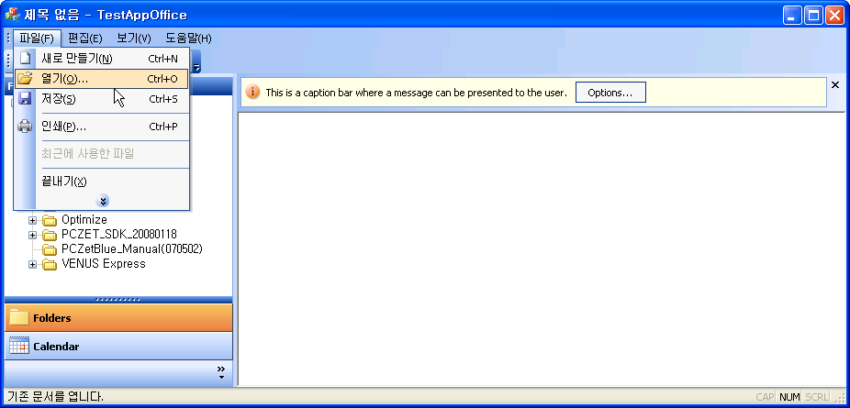
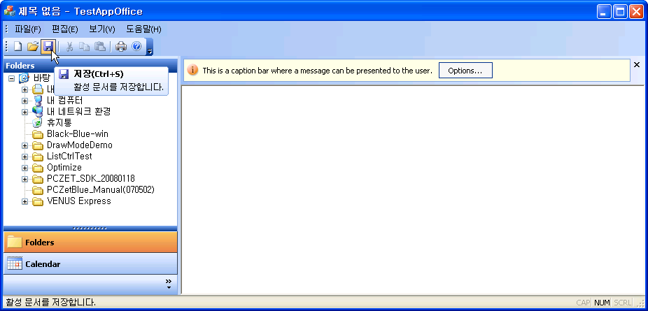
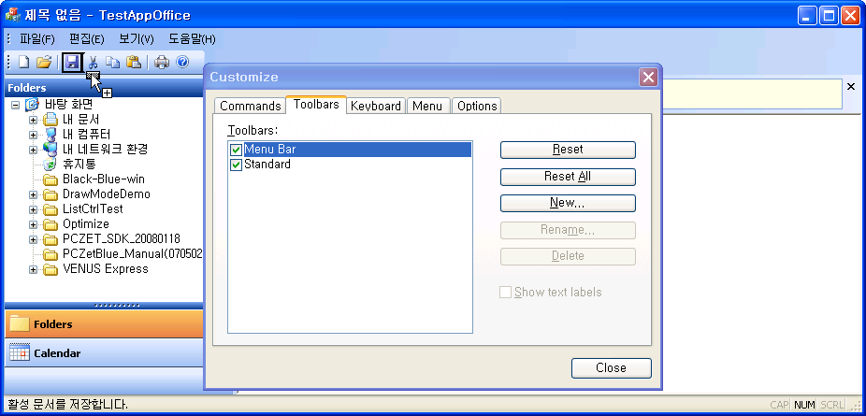
Menu bar & Tool bar

Slide 6
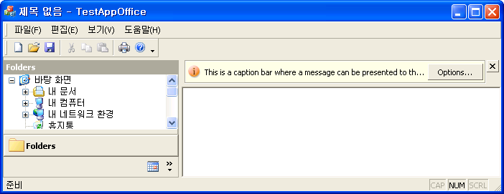

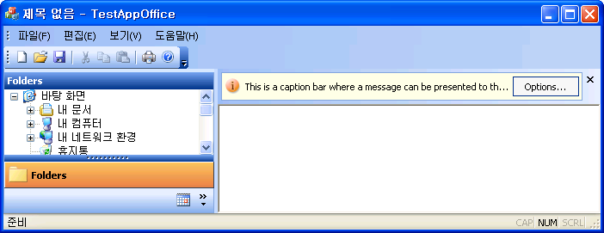
Visual style - 2K/XP/Office 2003

Slide 7
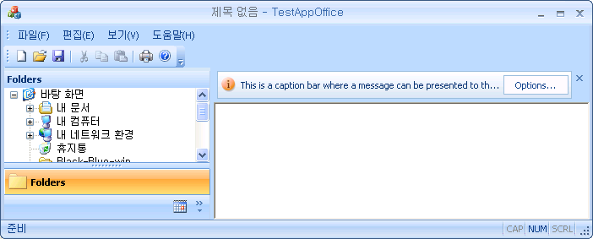
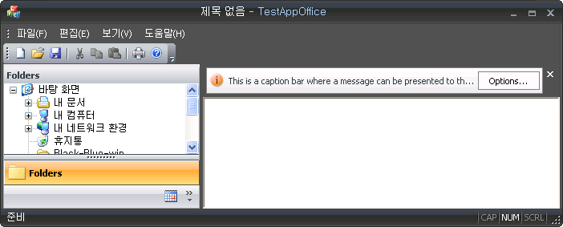
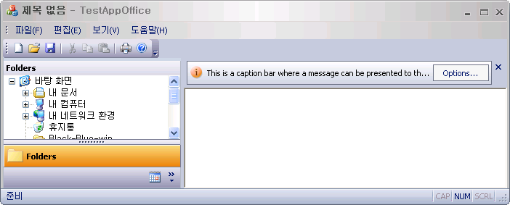
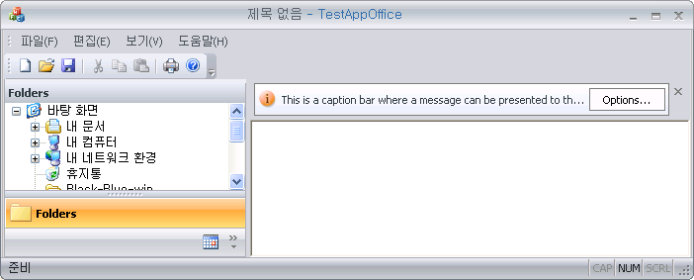
Visual style - Office 2007

Slide 8
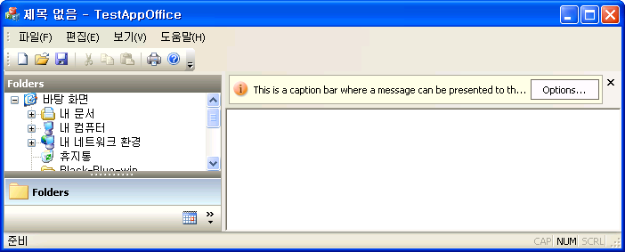
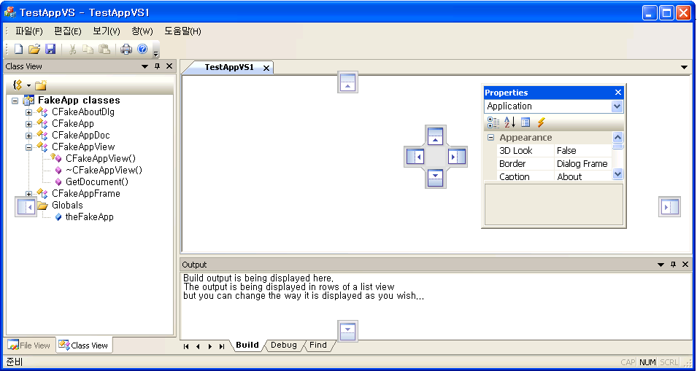
Visual style - Visual studio 2005

Slide 9
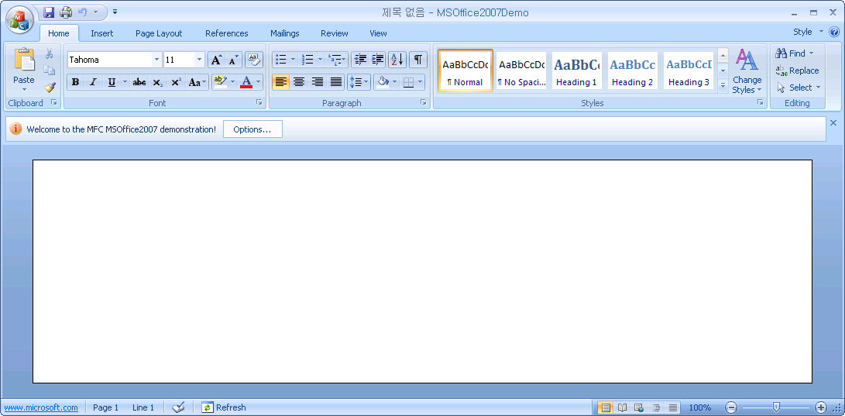
Visual style - Office 2007 sample
http://cafe.naver.com/windev/436
http://cafe.naver.com/windev/437
http://cafe.naver.com/windev/438

Slide 10
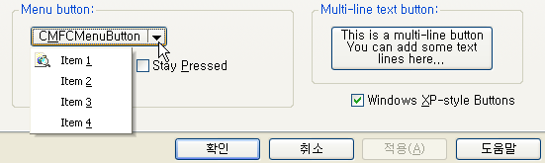
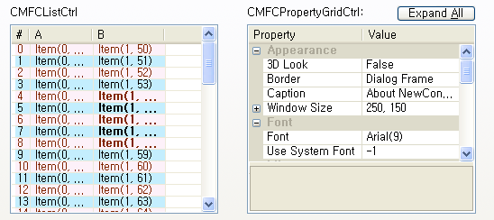
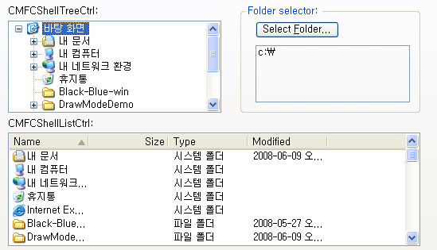
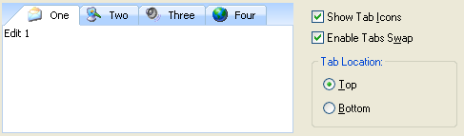
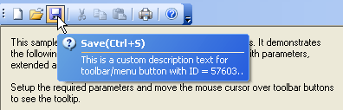
Extended control windows
http://cafe.naver.com/windev/109

Slide 11
MFC Feature Pack - Global object
afxContextMenuManager(CContextMenuManager)
afxKeyboardManager(CKeyboardManager)
afxMenuTearOffManager(CMenuTearOffManager)
afxMouseManager(CMouseManager)
afxShellManager(CShellManager)
afxUserToolsManager(CUserToolsManager)
76 SetRegistryKey(_T("로컬 응용 프로그램 마법사에서 생성된 응용 프로그램"));
77 LoadStdProfileSettings(4);
78
79 InitContextMenuManager( );
80
81 InitKeyboardManager( );
82
83 InitTooltipManager( );
84 CMFCToolTipInfo ttParams;
85 ttParams.m_bVislManagerTheme = TRUE;
86 theApp.GetTooltipManager( )->SetTooltipParams(AFX_TOOLTIP_TYPE_ALL,
87 RUNTIME_CLASS(CMFCToolTipCtrl), &ttParams);
88

Slide 12
LoadState()
159
160 // CTestAppMfcFpApp customization load/save methods
161
162 void CTestAppMfcFpApp::PreLoadState( )
163 {
164 BOOL bNameValid;
165 CString strName;
166 bNameValid = strName.LoadString(IDS_EDIT_MENU);
167 ASSERT(bNameValid);
168 GetContextMenuManager( )->AddMenu(strName, IDR_POPUP_EDIT);
169 }
170
171 void CTestAppMfcFpApp::LoadCustomState( )
172 {
173 }
174
175 void CTestAppMfcFpApp::SaveCustomState( )
176 {
177 }
178

Slide 13
CFrameWndEx
32
33 protected: // 컨트롤 모음이 포함된 멤버입니다.
34 CMFCMenuBar m_wndMenuBar;
35 CMFCToolBar m_wndToolBar;
36 CMFCStatusBar m_wndStatusBar;
37 CMFCToolBarImages m_UserImages;
38
39 // 생성된 메시지 맵 함수
40 protected:
41 afx_msg int OnCreate(LPCREATESTRUCT lpCreateStruct);
42 afx_msg void OnViewCustomize( );
43 afx_msg LRESULT OnToolbarCreateNew(WPARAM wp, LPARAM lp);
44 afx_msg void OnApplicationLook(UINT id);
45 afx_msg void OnUpdateApplicationLook(CCmdUI* pCmdUI);
46 DECLARE_MESSAGE_MAP( )
47
48 };
49

Slide 14
CFrameWndEx
21
22 BEGIN_MESSAGE_MAP(CMainFrame, CFrameWndEx)
23 ON_WM_CREATE( )
24 ON_COMMAND(ID_VIEW_CUSTOMIZE, &CMainFrame::OnViewCustomize)
25 ON_REGISTERED_MESSAGE(AFX_WM_CREATETOOLBAR, &CMainFrame::OnToolbarCreateNew)
26 ON_COMMAND_RANGE(ID_VIEW_APPLOOK_WIN_2000, ID_VIEW_APPLOOK_OFF_2007_AQUA, &CMainFrame::OnApplicationLook)
27 ON_UPDATE_COMMAND_UI_RANGE(ID_VIEW_APPLOOK_WIN_2000, ID_VIEW_APPLOOK_OFF_2007_AQUA, &CMainFrame::OnUpdateApplicationLook)
28 END_MESSAGE_MAP( )

Slide 15
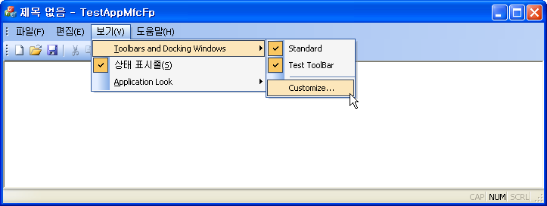
CFrameWndEx
21
22 BEGIN_MESSAGE_MAP(CMainFrame, CFrameWndEx)
23 ON_WM_CREATE( )
24 ON_COMMAND(ID_VIEW_CUSTOMIZE, &CMainFrame::OnViewCustomize)
25 ON_REGISTERED_MESSAGE(AFX_WM_CREATETOOLBAR, &CMainFrame::OnToolbarCreateNew)
26 ON_COMMAND_RANGE(ID_VIEW_APPLOOK_WIN_2000, ID_VIEW_APPLOOK_OFF_2007_AQUA, &CMainFrame::OnApplicationLook)
27 ON_UPDATE_COMMAND_UI_RANGE(ID_VIEW_APPLOOK_WIN_2000, ID_VIEW_APPLOOK_OFF_2007_AQUA, &CMainFrame::OnUpdateApplicationLook)
28 END_MESSAGE_MAP( )

Slide 16
CFrameWndEx
47
48 //----------------------------------
49 // Toolbar notification messages:
50 //----------------------------------
51 extern AFX_IMPORT_DATA UINT AFX_WM_TOOLBARMENU;
52 extern AFX_IMPORT_DATA UINT AFX_WM_CUSTOMIZETOOLBAR;
53 extern AFX_IMPORT_DATA UINT AFX_WM_CREATETOOLBAR;
54 extern AFX_IMPORT_DATA UINT AFX_WM_DELETETOOLBAR;
55 extern AFX_IMPORT_DATA UINT AFX_WM_CUSTOMIZEHELP;
56 extern AFX_IMPORT_DATA UINT AFX_WM_RESETTOOLBAR;
57 extern AFX_IMPORT_DATA UINT AFX_WM_RESETMENU;
58 extern AFX_IMPORT_DATA UINT AFX_WM_SHOWREGULARMENU;
59 extern AFX_IMPORT_DATA UINT AFX_WM_RESETCONTEXTMENU;
60 extern AFX_IMPORT_DATA UINT AFX_WM_RESETKEYBOARD;
61 extern AFX_IMPORT_DATA UINT AFX_WM_RESETRPROMPT;
62

Slide 17
CFrameWndEx
187 LRESULT CMainFrame::OnToolbarCreateNew(WPARAM wp,LPARAM lp)
188 {
189 LRESULT lres = CFrameWndEx::OnToolbarCreateNew(wp,lp);
190 if (lres == 0)
191 {
192 return 0;
193 }
194
195 CMFCToolBar* pUserToolbar = (CMFCToolBar*)lres;
196 ASSERT_VALID(pUserToolbar);
197
198 BOOL bNameValid;
199 CString strCustomize;
200 bNameValid = strCustomize.LoadString(IDS_TOOLBAR_CUSTOMIZE);
201 ASSERT(bNameValid);
202
203 pUserToolbar->EnableCustomizeButton(TRUE, ID_VIEW_CUSTOMIZE, strCustomize);
204 return lres;
205 }
206

Slide 18
CFrameWndEx
207 void CMainFrame::OnApplicationLook(UINT id)
208 {
209 CWaitCursor wait;
210
211 theApp.m_nAppLook = id;
212
213 switch (theApp.m_nAppLook)
214 {
215 case ID_VIEW_APPLOOK_WIN_2000:
216 CMFCVisualManager::SetDefaultManager(RUNTIME_CLASS(CMFCVisualManager));
217 break;
218

Slide 19
CFrameWndEx::OnCreate()
49
50 int CMainFrame::OnCreate(LPCREATESTRUCT lpCreateStruct)
51 {
52 if (CFrameWndEx::OnCreate(lpCreateStruct) == -1)
53 return -1;
54
55 BOOL bNameValid;
56 // set the visual manager and style based on persisted value
57 OnApplicationLook(theApp.m_nAppLook);
58
59 if (!m_wndMenuBar.Create(this))
60 {
61 TRACE0("Failed to create menubar\n");
62 return -1; // fail to create
63 }
64
65 m_wndMenuBar.SetPaneStyle(m_wndMenuBar.GetPaneStyle( ) |
66 CBRS_SIZE_DYNAMIC | CBRS_TOOLTIPS | CBRS_FLYBY);
67
68 // prevent the menu bar from taking the focus on activation
69 CMFCPopupMenu::SetForceMenuFocus(FALSE);
70

Slide 20
CFrameWndEx::OnCreate()
71 if (!m_wndToolBar.CreateEx(this, TBSTYLE_FLAT,
72 WS_CHILD | WS_VISIBLE |
73 CBRS_TOP | CBRS_GRIPPER | CBRS_TOOLTIPS |
74 CBRS_FLYBY | CBRS_SIZE_DYNAMIC) ||
75 !m_wndToolBar.LoadToolBar(theApp.m_bHiColorIcons ? IDR_MAINFRAME_256 : IDR_MAINFRAME))
76 {
77 TRACE0("도구 모음을 만들지 못했습니다.\n");
78 return -1; // fail to create
79 }
80
81 CString strToolBarName;
82 bNameValid = strToolBarName.LoadString(IDS_TOOLBAR_STANDARD);
83 ASSERT(bNameValid);
84 m_wndToolBar.SetWindowText(strToolBarName);
85
86 CString strCustomize;
87 bNameValid = strCustomize.LoadString(IDS_TOOLBAR_CUSTOMIZE);
88 ASSERT(bNameValid);
89 m_wndToolBar.EnableCustomizeButton(TRUE, ID_VIEW_CUSTOMIZE, strCustomize);
90
91 // Allow user-defined toolbars operations:
92 InitUserToolbars(NULL, uiFirstUserToolBarId, uiLastUserToolBarId);

Slide 21
CFrameWndEx::OnCreate()
108
109 // enable Visual Studio 2005 style docking window behavior
110 CDockingManager::SetDockingMode(DT_SMART);
111 // enable Visual Studio 2005 style docking window auto-hide behavior
112 EnableAutoHidePanes(CBRS_ALIGN_ANY);
113
114 // Enable toolbar and docking window menu replacement
115 EnablePaneMenu(TRUE, ID_VIEW_CUSTOMIZE, strCustomize, ID_VIEW_TOOLBAR);
116
117 // enable quick (Alt+drag) toolbar customization
118 CMFCToolBar::EnableQuickCustomization( );
119
120 if (CMFCToolBar::GetUserImages( ) == NULL)
121 {
122 // load user-defined toolbar images
123 if (m_UserImages.Load(_T(".\\UserImages.bmp")))
124 {
125 m_UserImages.SetImageSize(CSize(16, 16), FALSE);
126 CMFCToolBar::SetUserImages(&m_UserImages);
127 }
128 }
129

Slide 22
CFrameWndEx::OnCreate()
108
109 // enable Visual Studio 2005 style docking window behavior
110 CDockingManager::SetDockingMode(DT_SMART);
111 // enable Visual Studio 2005 style docking window auto-hide behavior
112 EnableAutoHidePanes(CBRS_ALIGN_ANY);
113
114 // Enable toolbar and docking window menu replacement
115 EnablePaneMenu(TRUE, ID_VIEW_CUSTOMIZE, strCustomize, ID_VIEW_TOOLBAR);
116
117 // enable quick (Alt+drag) toolbar customization
118 CMFCToolBar::EnableQuickCustomization( );
119
120 if (CMFCToolBar::GetUserImages( ) == NULL)
121 {
122 // load user-defined toolbar images
123 if (m_UserImages.Load(_T(".\\UserImages.bmp")))
124 {
125 m_UserImages.SetImageSize(CSize(16, 16), FALSE);
126 CMFCToolBar::SetUserImages(&m_UserImages);
127 }
128 }
129

Slide 23
Chapter 25
  Pane window

Slide 24
CPane Hierarchy chart
CWnd
CBasePane
CPane
CDockablePane
CBaseTabbedPane
CTabbedPane
CMFCBaseToolBar
CMFCToolBar
CMFCMenuBar

Slide 25
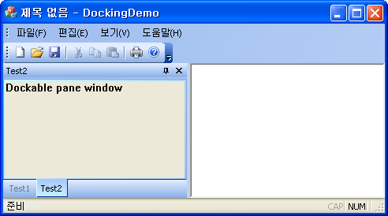
CDockablePane class
CMFCMenuBar
CMFCReBar
CTabbedPane
CMFCToolBar
CDockablePane
CMFCStatusBar

Slide 26
True color tool bar
67
68 if (!m_wndToolBar.CreateEx(this, TBSTYLE_FLAT, WS_CHILD | WS_VISIBLE |
69 CBRS_TOP | CBRS_GRIPPER | CBRS_TOOLTIPS |
70 CBRS_FLYBY | CBRS_SIZE_DYNAMIC) ||
71 !m_wndToolBar.LoadToolBar(theApp.m_bHiColorIcons ? IDR_MAINFRAME_256 : IDR_MAINFRAME))
72 {
73 TRACE0("도구 모음을 만들지 못했습니다.\n");
74 return -1; // fail to create
75 }
76
31
32 CNewToolBarApp::CNewToolBarApp( )
33 {
34
35 m_bHiColorIcons = TRUE;
36
37 // TODO: 여기에 생성 코드를 추가합니다.
38 // InitInstance에 모든 중요한 초기화 작업을 배치합니다.
39 }
40

Slide 27
NewToolBar
CMFCToolBarButton(
UINT uiID,
int iImage,
LPCTSTR lpszText=NULL,
BOOL bUserButton=FALSE,
BOOL bLocked=FALSE
);
126
127 CMFCToolBarButton btnNewFile(ID_FILE_OPEN, 0, _T("TEST"));
128 m_wndToolBar.InsertSeparator( );
129 m_wndToolBar.InsertButton(btnNewFile);
130
131 m_wndToolBar.AdjustSizeImmediate( );
132
133 return 0;
134 }
135

Slide 28
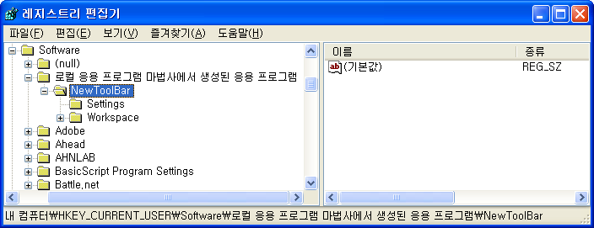
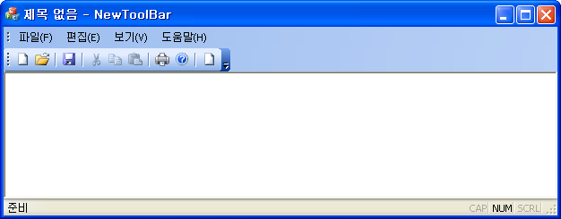
NewToolBar

Slide 29
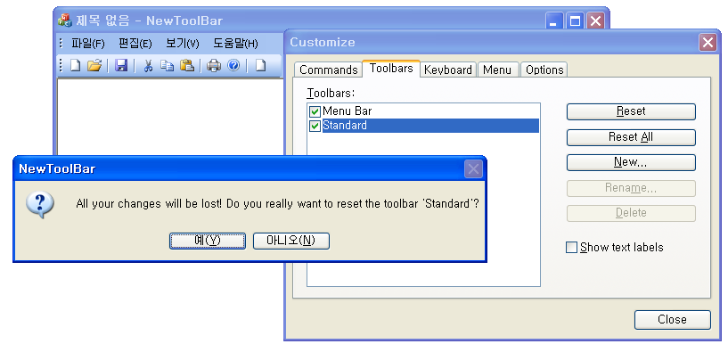
NewToolBar - AFX_WM_RESETTOOLBAR

Slide 30
NewToolBar - AFX_WM_RESETTOOLBAR message handler 1
38
39 // 생성된 메시지맵 함수
40 protected:
41 afx_msg int OnCreate(LPCREATESTRUCT lpCreateStruct);
42 afx_msg void OnViewCustomize( );
43 afx_msg LRESULT OnToolbarCreateNew(WPARAM wp, LPARAM lp);
44 DECLARE_MESSAGE_MAP( )
45
46 afx_msg LRESULT OnResetToolBar(WPARAM wParam, LPARAM lParam);
47 };
48

Slide 31
NewToolBar - AFX_WM_RESETTOOLBAR message handler 2
21
22 BEGIN_MESSAGE_MAP(CMainFrame, CFrameWndEx)
23 ON_WM_CREATE( )
24 ON_COMMAND(ID_VIEW_CUSTOMIZE, &CMainFrame::OnViewCustomize)
25 ON_REGISTERED_MESSAGE(AFX_WM_CREATETOOLBAR, &CMainFrame::OnToolbarCreateNew)
26 ON_REGISTERED_MESSAGE(AFX_WM_RESETTOOLBAR, OnResetToolBar)
27 END_MESSAGE_MAP( )
28

Slide 32
NewToolBar - AFX_WM_RESETTOOLBAR message handler 3
217
218 LRESULT CMainFrame::OnResetToolBar(WPARAM wParam, LPARAM lParam)
219 {
220 UINT uID = (UINT)wParam;
221 if(uID == IDR_MAINFRAME_256)
222 {
223 CMFCToolBarButton btnNewFile(ID_FILE_OPEN, 0, _T("TEST"));
224 m_wndToolBar.InsertSeparator( );
225 m_wndToolBar.InsertButton(btnNewFile);
226 }
227
228 return 0;
229 }
230

Slide 33

NewToolBar - Button style
01 LRESULT CMainFrame::OnResetToolBar(WPARAM wParam, LPARAM lParam)
02 {
03 UINT uID = (UINT)wParam;
04 if(uID == IDR_MAINFRAME_256)
05 {
06 CMFCToolBarButton btnNewFile(ID_FILE_OPEN, 0, _T("TEST"));
07 m_wndToolBar.InsertSeparator( );
08 m_wndToolBar.InsertButton(btnNewFile);
09
10 m_wndToolBar.SetToolBarBtnText(1, _T("Open"), TRUE, TRUE);
11 }
12
13 return 0;
14 }

Slide 34
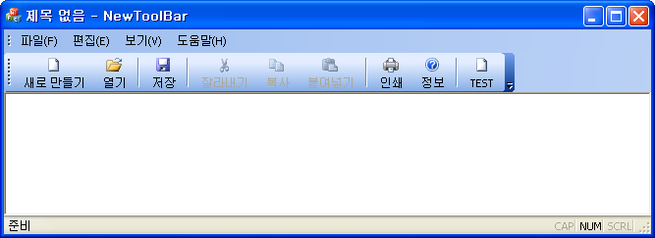
NewToolBar - Button style
211
212 LRESULT CMainFrame::OnResetToolBar(WPARAM wParam, LPARAM lParam)
213 {
214 UINT uID = (UINT)wParam;
215 if(uID == IDR_MAINFRAME_256)
216 {
217 CMFCToolBarButton btnNewFile(ID_FILE_OPEN, 0, _T("TEST"));
218 m_wndToolBar.InsertSeparator( );
219 m_wndToolBar.InsertButton(btnNewFile);
220
221 // m_wndToolBar.SetToolBarBtnText(1, _T("Open"), TRUE, TRUE);
222 m_wndToolBar.EnableTextLabels(TRUE);
223 }
224
225 return 0;
226 }
227

Slide 35
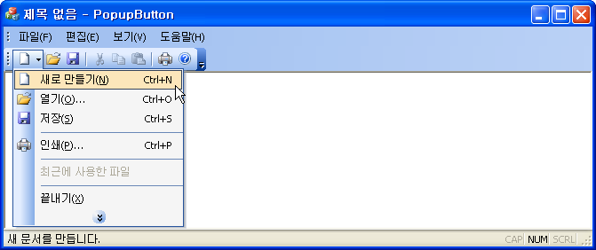
NewToolBar - Drop-down Button
227
228 LRESULT CMainFrame::OnResetToolBar(WPARAM wParam, LPARAM lParam)
229 {
230 UINT uID = (UINT)wParam;
231 if(uID == IDR_MAINFRAME_256)
232 {
233 CMenu MainMenu;
234 MainMenu.LoadMenu(IDR_MAINFRAME);
235 CMenu* pMenu = MainMenu.GetSubMenu(0);
236
237 m_wndToolBar.ReplaceButton(ID_FILE_NEW,
238 CMFCToolBarMenuButton(
239 (UINT)-1,
240 *pMenu,
241 0,
242 _T("Drop-down button"))
243 );
244 }
245
246 return 0;
247 }
248

Slide 36
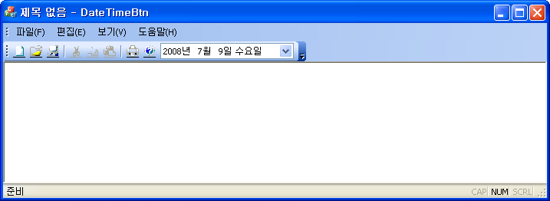
NewToolBar - Date-time picker
227
228 LRESULT CMainFrame::OnResetToolBar(WPARAM wParam, LPARAM lParam)
229 {
230 UINT uID = (UINT)wParam;
231 if(uID == IDR_MAINFRAME_256)
232 {
233 m_wndToolBar.ReplaceButton (ID_Menu_DateTimeButton,
234 CMFCToolBarDateTimeCtrl(
235 ID_Menu_DateTimeButton,
236 0,
237 DTS_LONGDATEFORMAT,
238 180)
239 );
240 }
241
242 return 0;
243 }
244

Slide 37
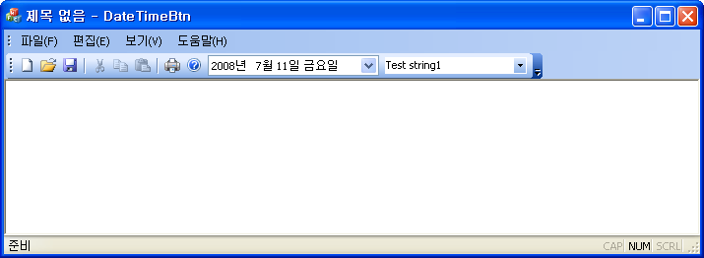
NewToolBar - ComboBox button
233
234 LRESULT CMainFrame::OnResetToolBar(WPARAM wParam, LPARAM lParam)
235 {
236 UINT uID = (UINT)wParam;
237 if(uID == IDR_MAINFRAME_256)
238 {
239 m_wndToolBar.ReplaceButton (ID_Menu_DateTimeButton,
240 CMFCToolBarDateTimeCtrl(
241 ID_Menu_DateTimeButton,
242 0,
243 DTS_LONGDATEFORMAT,
244 180)
245 );
246 CMFCToolBarComboBoxButton btnCombo(ID_Menu_FindCombo, 0, CBS_DROPDOWN | CBS_SORT);
247 btnCombo.SetDropDownHeight(100);
248 btnCombo.AddItem(_T("Test string1"));
249 btnCombo.AddItem(_T("Test string2"));
250 btnCombo.SelectItem(0);
251
252 m_wndToolBar.ReplaceButton (ID_Menu_FindCombo, btnCombo);
253 }
254
255 return 0;
256 }
257

Slide 38
NewToolBar - ComboBox button
280
281 void CMainFrame::OnMenuFindcombo( )
282{
283 CString strTmp = _T("");
284 int nCount = m_wndToolBar.GetCount( );
285 CMFCToolBarButton* pButton = NULL;
286 CMFCToolBarComboBoxButton* pComboButton = NULL;
287
288 for(int i = 0; i < nCount; ++i)
289 {
290 pButton = m_wndToolBar.GetButton(i);
291 if(pButton != NULL && pButton->m_nID == ID_Menu_FindCombo)
292 {
293 pComboButton = (CMFCToolBarComboBoxButton*)pButton;
294 CEdit* pEdit = pComboButton->GetEditCtrl( );
295 pEdit->GetWindowText(strTmp);
296 AfxMessageBox(strTmp);
297
298 CComboBox* pCombo = pComboButton->GetComboBox( );
299 if(pCombo->FindStringExact(-1, strTmp) < 0)
300 {
301 pCombo->AddString(strTmp);
302 }
303 }
304 }
305 }
306

Slide 39
NewStatusBar
141
142 CMFCToolBar::SetBasicCommands(lstBasicCommands);
143
144 CImageList ImageList;
145 ImageList.Create(IDB_Led, 15, 4, RGB(255, 255, 255));
146 m_wndStatusBar.SetPaneAnimation(0, ImageList, 700);
147
148 m_wndStatusBar.SetPaneWidth(1, 200);
149 m_wndStatusBar.EnablePaneProgressBar(1, 100, TRUE);
150 m_wndStatusBar.SetPaneProgress(1, m_nProgress);
151 SetTimer(100, 200, NULL);
152
153 return 0;
154 }
155

Slide 40
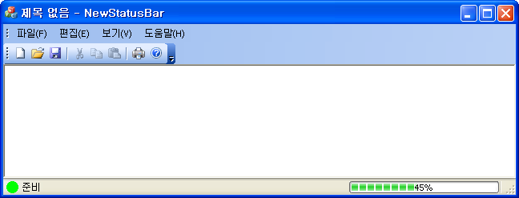
NewStatusBar
237
238 void CMainFrame::OnTimer(UINT_PTR nIDEvent)
239 {
240 m_nProgress += 5;
241 if(m_nProgress > 100) m_nProgress = 0;
242
243 m_wndStatusBar.SetPaneProgress(1, m_nProgress);
244 CFrameWndEx::OnTimer(nIDEvent);
245 }
246

Slide 41
Chapter 26
  Visual style

Slide 42
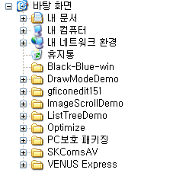
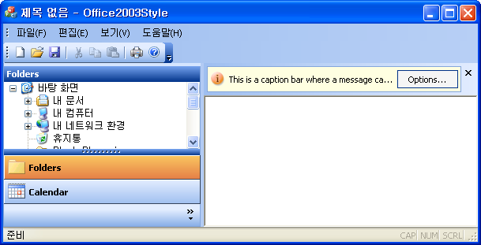
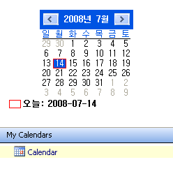
Office 2003 style
CMFCShellTreeCtrl
CMFCCaptionBar
CCalendarBar : public CWnd
COutlookBar: public CMFCOutlookBar

Slide 43
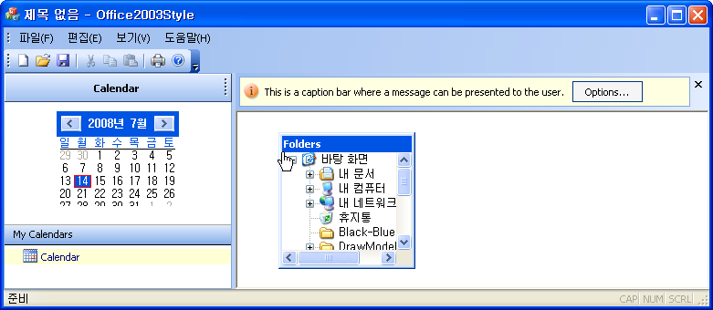
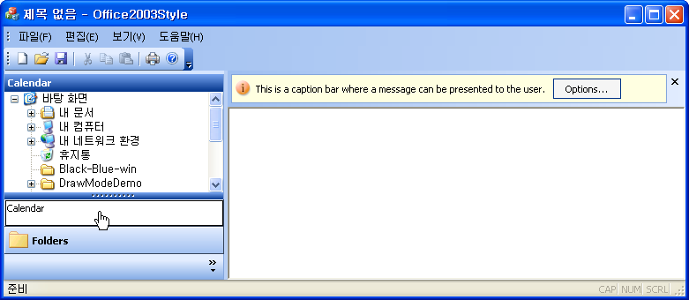
Office 2003 style

Slide 44
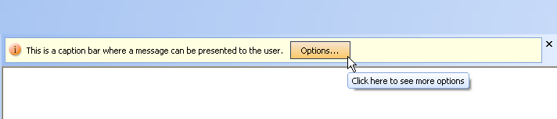
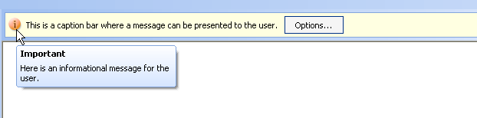
Office 2003 style - caption

Slide 45
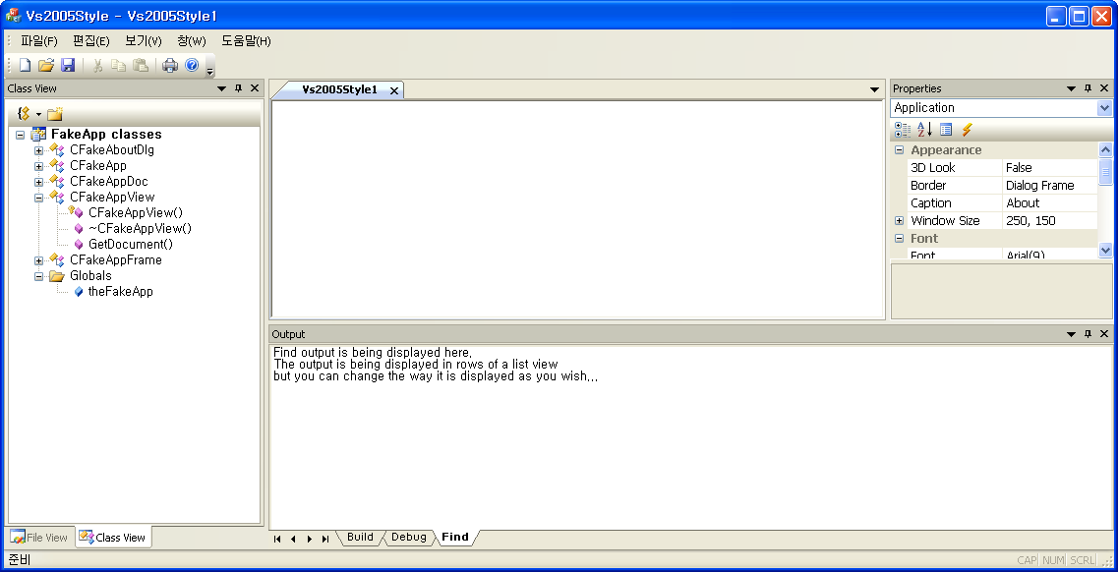
Visual style - VS2005
35
36 protected: // 컨트롤 모음이 포함된 멤버입니다.
37 CMFCMenuBar m_wndMenuBar;
38 CMFCToolBar m_wndToolBar;
39 CMFCStatusBar m_wndStatusBar;
40 CMFCToolBarImages m_UserImages;
41 CFileView m_wndFileView;
42 CClassView m_wndClassView;
43 COutputWnd m_wndOutput;
44 CPropertiesWnd m_wndProperties;
45

Slide 46
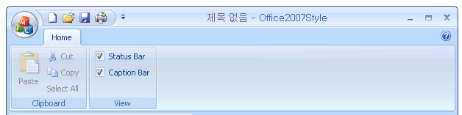

Visual style - Office 2007 (Ribbon UI)
Quick access toolbar
Main button
Quick access customize button
Ribbon button
Category item (Tab)
Ribbon panel

Slide 47
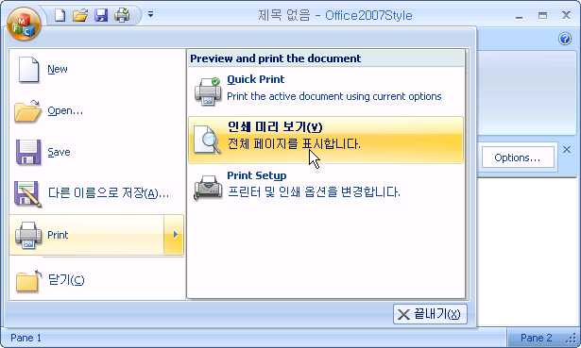
Visual style - Office 2007 (Ribbon UI)
Sub panel
Main panel
Items

Slide 48
Ribbon UI
193
194 // Create "Clipboard" panel:
195 bNameValid = strTemp.LoadString(IDS_RIBBON_CLIPBOARD);
196 ASSERT(bNameValid);
197 CMFCRibbonPanel* pPanelClipboard = pCategoryHome->AddPanel(
198 strTemp, m_PanelImages.ExtractIcon(27));
199
200 bNameValid = strTemp.LoadString(IDS_RIBBON_PASTE);
201 ASSERT(bNameValid);
202 CMFCRibbonButton* pBtnPaste = new CMFCRibbonButton(ID_EDIT_PASTE, strTemp, 0, 0);
203 pPanelClipboard->Add(pBtnPaste);
204
205 bNameValid = strTemp.LoadString(IDS_RIBBON_CUT);
206 ASSERT(bNameValid);
207 pPanelClipboard->Add(new CMFCRibbonButton(ID_EDIT_CUT, strTemp, 1));
208 bNameValid = strTemp.LoadString(IDS_RIBBON_COPY);
209 ASSERT(bNameValid);
210 pPanelClipboard->Add(new CMFCRibbonButton(ID_EDIT_COPY, strTemp, 2));
211 bNameValid = strTemp.LoadString(IDS_RIBBON_SELECTALL);
212 ASSERT(bNameValid);
213 pPanelClipboard->Add(new CMFCRibbonButton(ID_EDIT_SELECT_ALL, strTemp, -1));
214

Slide 49
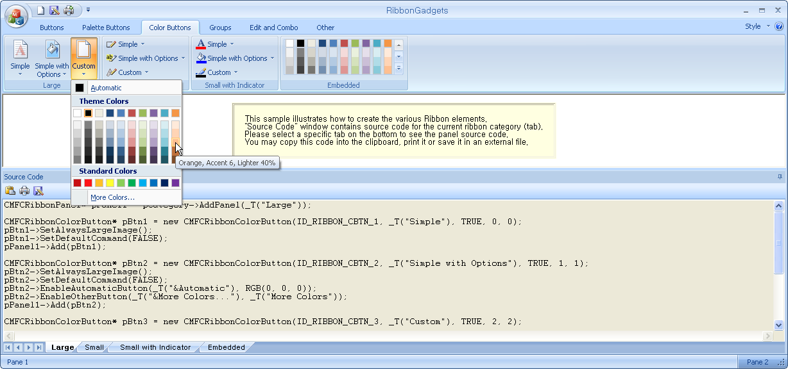
MFC Feature Pack sample - RibbonGadgets

Slide 50
Chapter 27
  Extended control windows

Slide 51
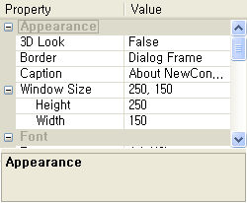
Property grid control (CMFCPropertyGridCtrl)
Header control
Group
Group item
Group item
Sub item
Description area

Slide 52
Property grid control (CMFCPropertyGridCtrl)
97 SetIcon(m_hIcon, TRUE); // 큰 아이콘을 설정합니다.
98 SetIcon(m_hIcon, FALSE); // 작은 아이콘을 설정합니다.
99
100 m_wndPropGrid.Create(WS_CHILD | WS_VISIBLE | WS_TABSTOP | WS_BORDER,
101 CRect(0, 0, 400, 250), this, 1234);
102 m_wndPropGrid.EnableHeaderCtrl(FALSE);
103 m_wndPropGrid.EnableDescriptionArea( );
104 m_wndPropGrid.SetVSDotNetLook(TRUE);
105 m_wndPropGrid.MarkModifiedProperties(TRUE);
106 m_wndPropGrid.SetAlphabeticMode(FALSE);
107
108 InitPropGrid( );
109 return TRUE; // 포커스를 컨트롤에 설정하지 않으면 TRUE를 반환합니다.
110 }
111

Slide 53
Property grid control (CMFCPropertyGridCtrl)
161
162 void CPropGridDemoDlg::InitPropGrid(void)
163 {
164 CMFCPropertyGridProperty* pGroupAppear = new CMFCPropertyGridProperty(_T("Appearance"));
165 m_wndPropGrid.AddProperty(pGroupAppear);
166
167 COleVariant var3DLook((short)VARIANT_FALSE, VT_BOOL);
168 pGroupAppear->AddSubItem(new CMFCPropertyGridProperty(
169 _T("3D Look"),
170 var3DLook,
171 _T("Specifies the dialog's font will be nonbold and controls will have a 3D border")));
172

Slide 54
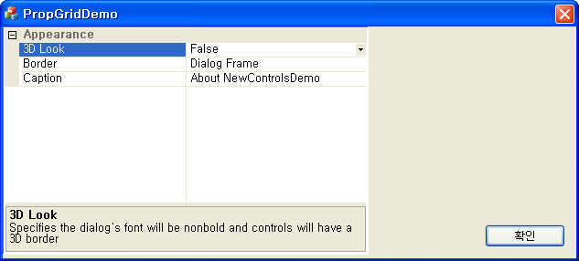
Property grid control (CMFCPropertyGridCtrl)
172
173 CMFCPropertyGridProperty* pProp = new CMFCPropertyGridProperty(
174 _T("Border"),
175 _T("Dialog Frame"),
176 _T("One of: None, Thin, Resizable, or Dialog Frame"));
177 pProp->AddOption(_T("None"));
178 pProp->AddOption(_T("Thin"));
179 pProp->AddOption(_T("Resizable"));
180 pProp->AddOption(_T("Dialog Frame"));
181 pProp->AllowEdit(FALSE);
182
183 pGroupAppear->AddSubItem(pProp);
184 pGroupAppear->AddSubItem(new CMFCPropertyGridProperty(
185 _T("Caption"),
186 (COleVariant) _T("About NewControlsDemo"),
187 _T("Specifies the text that will be displayed in the dialog's title bar")));
188 }
189

Slide 55
Property grid control (CMFCPropertyGridCtrl)
int AddProperty(
CMFCPropertyGridProperty* pProp,
BOOL bRedraw=TRUE,
BOOL bAdjustLayout=TRUE
);
- CMFCPropertyGridProperty(
const CString& strGroupName,
DWORD_PTR dwData=0,
BOOL bIsValueList=FALSE
);
- CMFCPropertyGridProperty(
const CString& strName,
const COleVariant& varValue,
LPCTSTR lpszDescr=NULL,
DWORD_PTR dwData=0,
LPCTSTR lpszEditMask=NULL,
LPCTSTR lpszEditTemplate=NULL,
LPCTSTR lpszValidChars=NULL
);

Slide 56
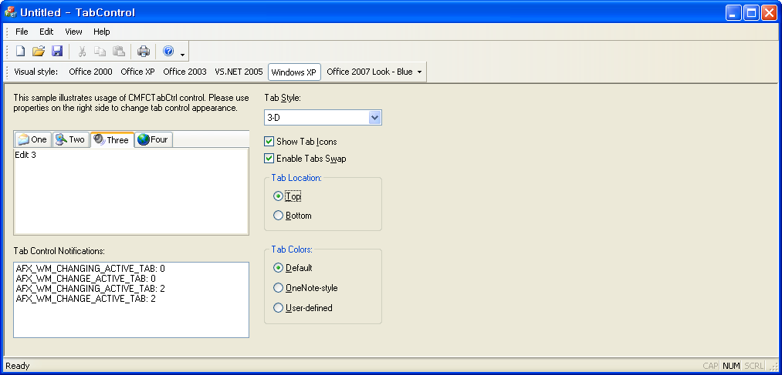
Tab control (CMFCTabCtrl)

Slide 57
Tab control (CMFCTabCtrl)
102
103 CRect rectTab;
104
105 m_wndTabLoc.GetWindowRect (&rectTab);
106 ScreenToClient (&rectTab);
107
108 m_wndTab.Create (CMFCTabCtrl::STYLE_3D, rectTab, this, 1,
109 CMFCTabCtrl::LOCATION_TOP);
110
111 m_wndTab.SetImageList (IDB_ICONS, 16, RGB (255, 0, 255));
112

Slide 58
Tab control (CMFCTabCtrl)
124
125 m_wnd4.Create (WS_CHILD | WS_VISIBLE, CRect (0, 0, 0, 0), &m_wndTab, 4);
126 m_wnd4.SetFont (&afxGlobalData.fontRegular);
127 m_wnd4.SetWindowText (_T("Edit 4"));
128
129 m_wndTab.AddTab (&m_wnd1, _T("One"), 0, FALSE);
130 m_wndTab.AddTab (&m_wnd2, _T("Two"), 1, FALSE);
131 m_wndTab.AddTab (&m_wnd3, _T("Three"), 2, FALSE);
132 m_wndTab.AddTab (&m_wnd4, _T("Four"), 3, FALSE);
133
42 // Tab control notifications
43 ON_REGISTERED_MESSAGE(AFX_WM_ON_MOVE_TAB, OnMoveTab)
44 ON_REGISTERED_MESSAGE(AFX_WM_CHANGE_ACTIVE_TAB, OnChangeActiveTab)
45 ON_REGISTERED_MESSAGE(AFX_WM_CHANGING_ACTIVE_TAB, OnChangingActiveTab)
46 END_MESSAGE_MAP( )
47

Slide 59
Shell Tree/List control
36
37 BOOL CShellTreeListDemoApp::InitInstance( )
38 {
39 INITCOMMONCONTROLSEX InitCtrls;
40 InitCtrls.dwSize = sizeof(InitCtrls);
41
42 InitCtrls.dwICC = ICC_WIN95_CLASSES;
43 InitCommonControlsEx(&InitCtrls);
44 InitShellManager( );
45
46 CWinAppEx::InitInstance( );
47
48 AfxEnableControlContainer( );
49

Slide 60
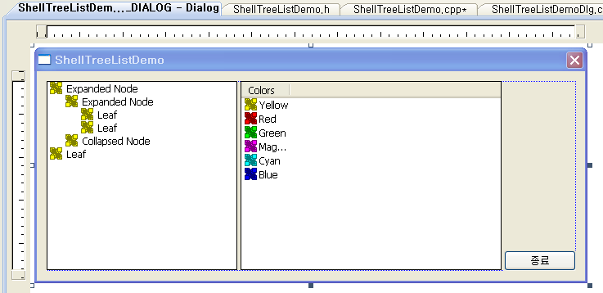
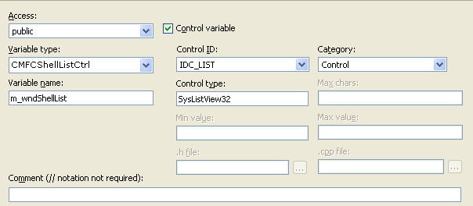
Shell Tree/List control

Slide 61
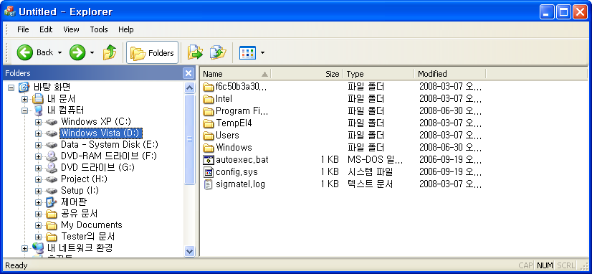
Shell Tree/List control
99 SetIcon(m_hIcon, TRUE); // 큰 아이콘을 설정합니다.
100 SetIcon(m_hIcon, FALSE); // 작은 아이콘을 설정합니다.
101
102 m_wndShellTree.Expand(m_wndShellTree.GetRootItem( ), TVE_EXPAND);
103 m_wndShellTree.SetRelatedList(&m_wndShellList);
104
105 return TRUE; // 포커스를 컨트롤에 설정하지 않으면 TRUE를 반환합니다.
106 }
107

